Slide 1
Unit Test And DCAF

Slide 2
Agenda
Introduction to Unit Test
Why do we need to unit test
LabVIEW Unit Test Framework
How to test Classes
What to test in DCAF
Included Tests
Notes:
The pruspose of this session is to give a quick introduction to unit test, as well as how it is applied in DCAF.

Slide 3
Difficulties of testing
Perception by some developers and managers:
Testing is seen as a novice's job.
Assigned to the least experienced team members.
Done as an afterthought (if at all).
"My code is good; it won't have bugs. I don't need to test it."
"I'll just find the bugs by running the client program."
Limitations of what testing can show you:
It is impossible to completely test a system.
Testing does not always directly reveal the actual bugs in the code.
Testing does not prove the absence of errors in software.

Slide 4
Unit Test – Do I Need It?
Do I ever make a mistake?
Do my colleagues?
Really?
No
No
Yes
Yes
YES
Notes:
Some of you may not be sold, so I offer you this handy flow chart to determine if your project can benefit from source code control.
We’ve all been there at some point, “branching” our code and saving copies by renaming zip files; we’ve all experienced the frustration and potential for accidently modifying the wrong files when using this method. Overall, we should all recognize that it’s very very bad.
For more details on source code control in LabVIEW, please see Eli Kerry’s Software Engineering Technical Manual and Exercises for LabVIEW: https://decibel.ni.com/content/docs/DOC-10122

Slide 5
Why to Do Unit Test
Find Bugs Early
Regression testing

Slide 6
Test Driven Design
What is it
When to use it?
Disadvantage

Slide 7
What should we test
Everything????
Nothing
Public APIs
How small is a UNit

Slide 8
What do we need to test?
Requirements
Time
Automation

Slide 9
Levels of Testing
Unit testing: the execution of a complete class, routine, or small program or team of programmers
Component testing: the execution of a class, package, small program, or other program element
Integration testing: the combined execution of two or more classes, packages, components, or subsystems
System testing: the execution of the software in its ﬁnal conﬁguration, including integration with other software and hardware systems Regression testing: the repetition of previously executed test cases for the purpose of ﬁnding defects

Slide 10
What should we test

Slide 11
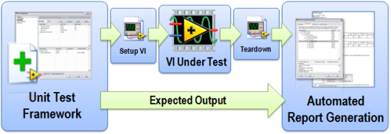
LabVIEW Unit Test
Notes:
http://www.ni.com/white-paper/8082/en/

Slide 12
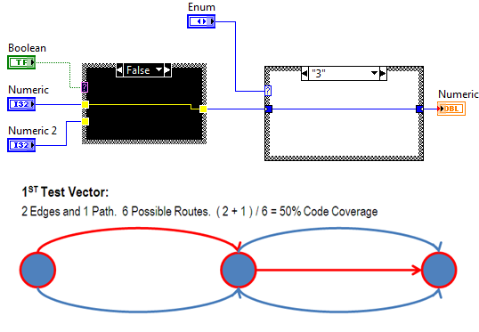
Code Coverage

Slide 13
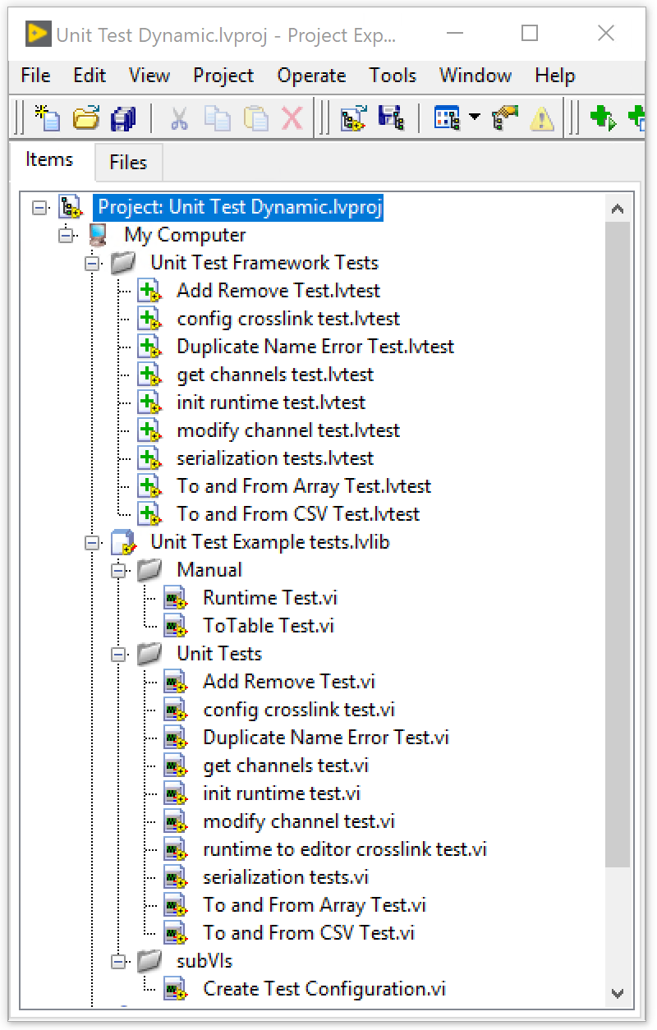
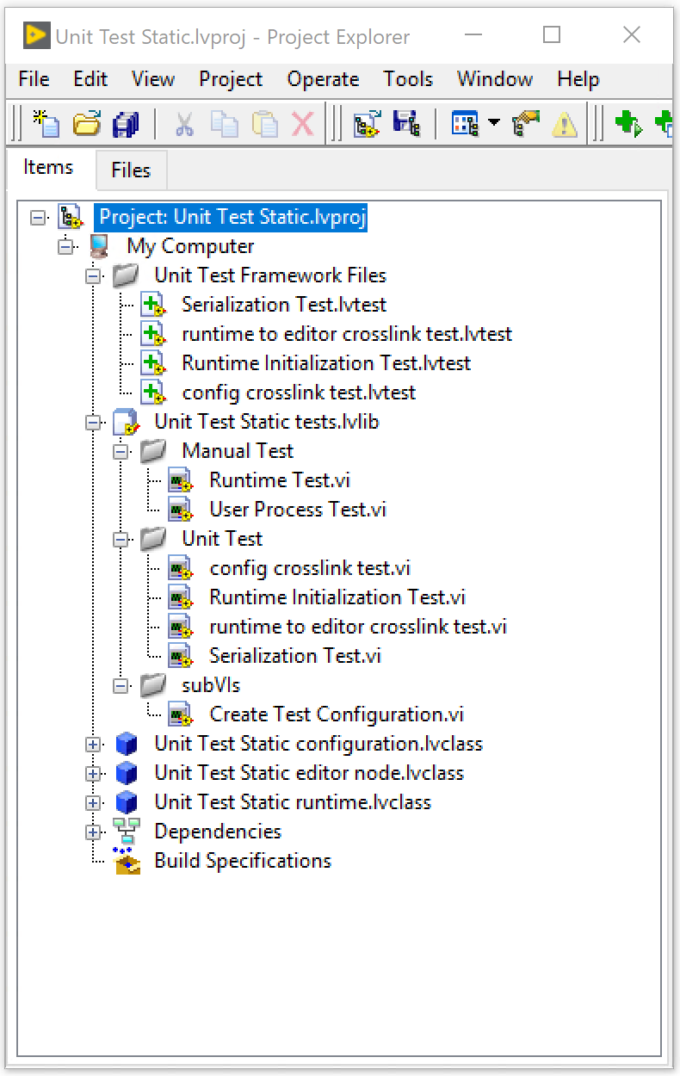
Unit Test In DCAF
Notes:
Templates already include some unit test that you can modify we are going to cover some of the most common ones as well as explain what we are doing .

Slide 14
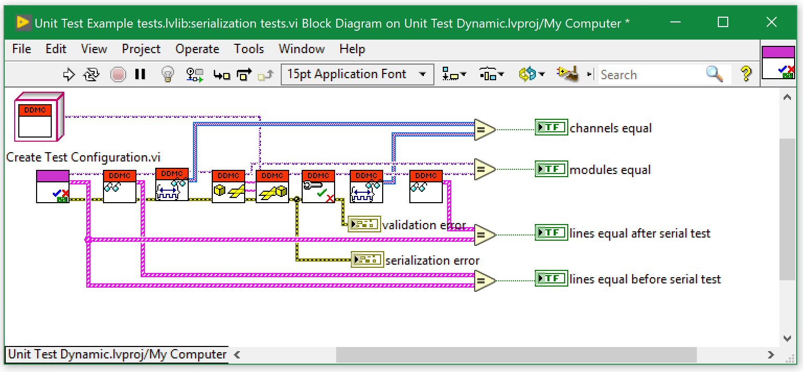
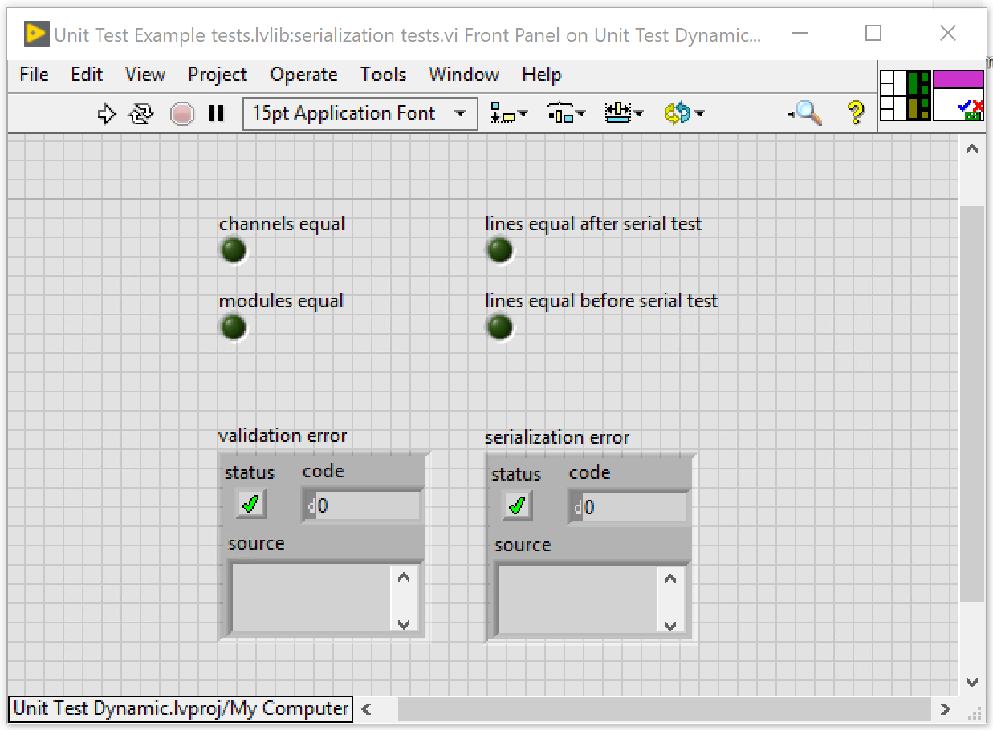
Serialization Test

Slide 15
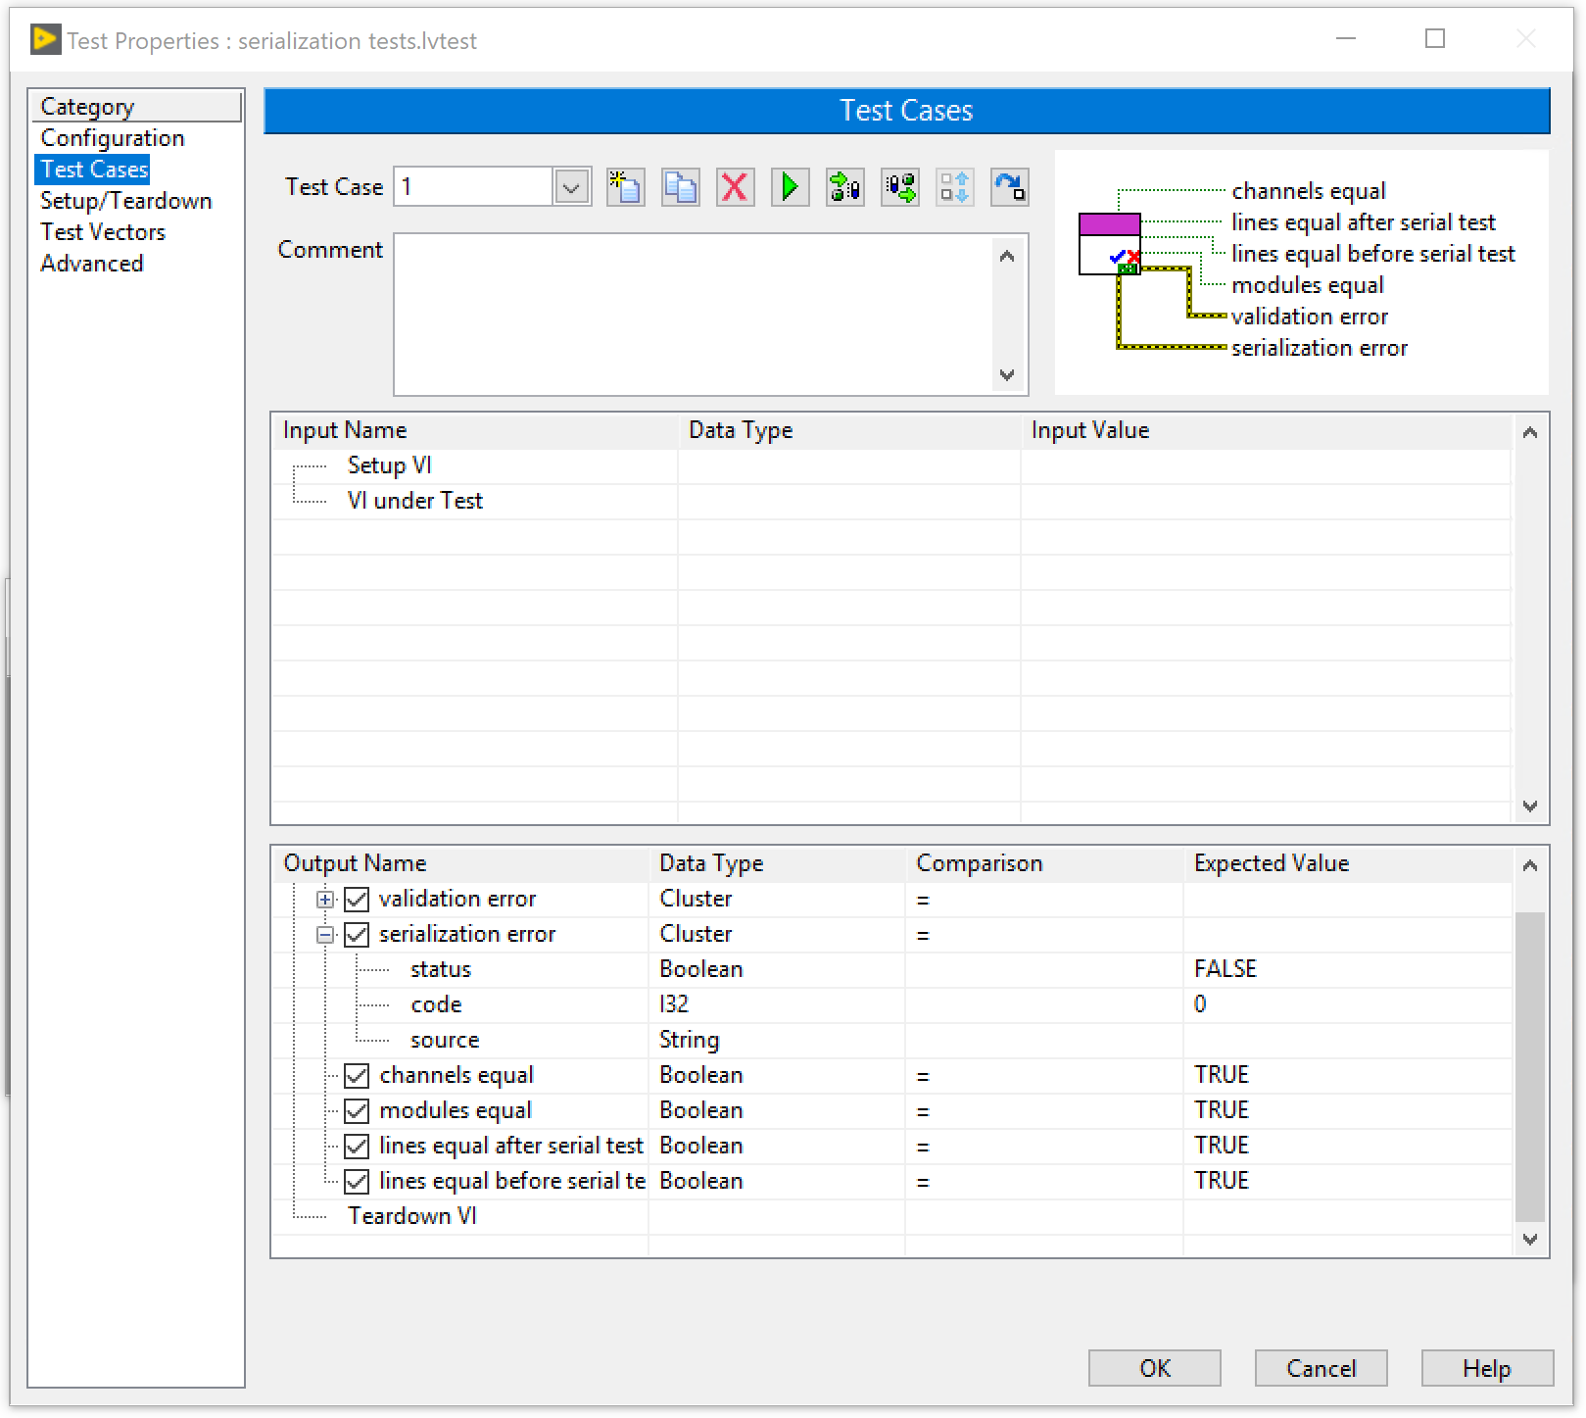

Slide 16
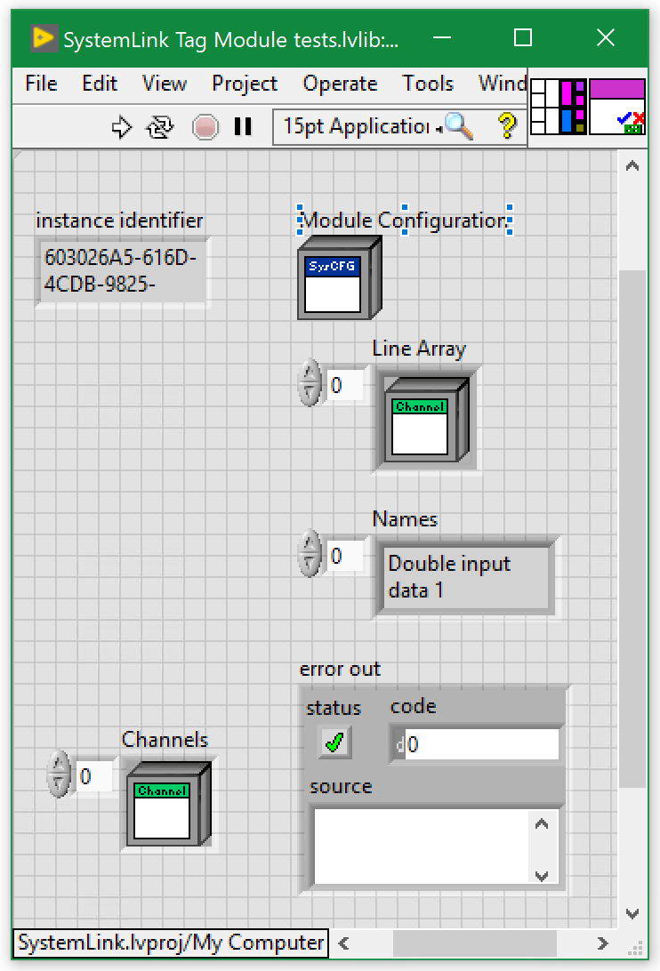
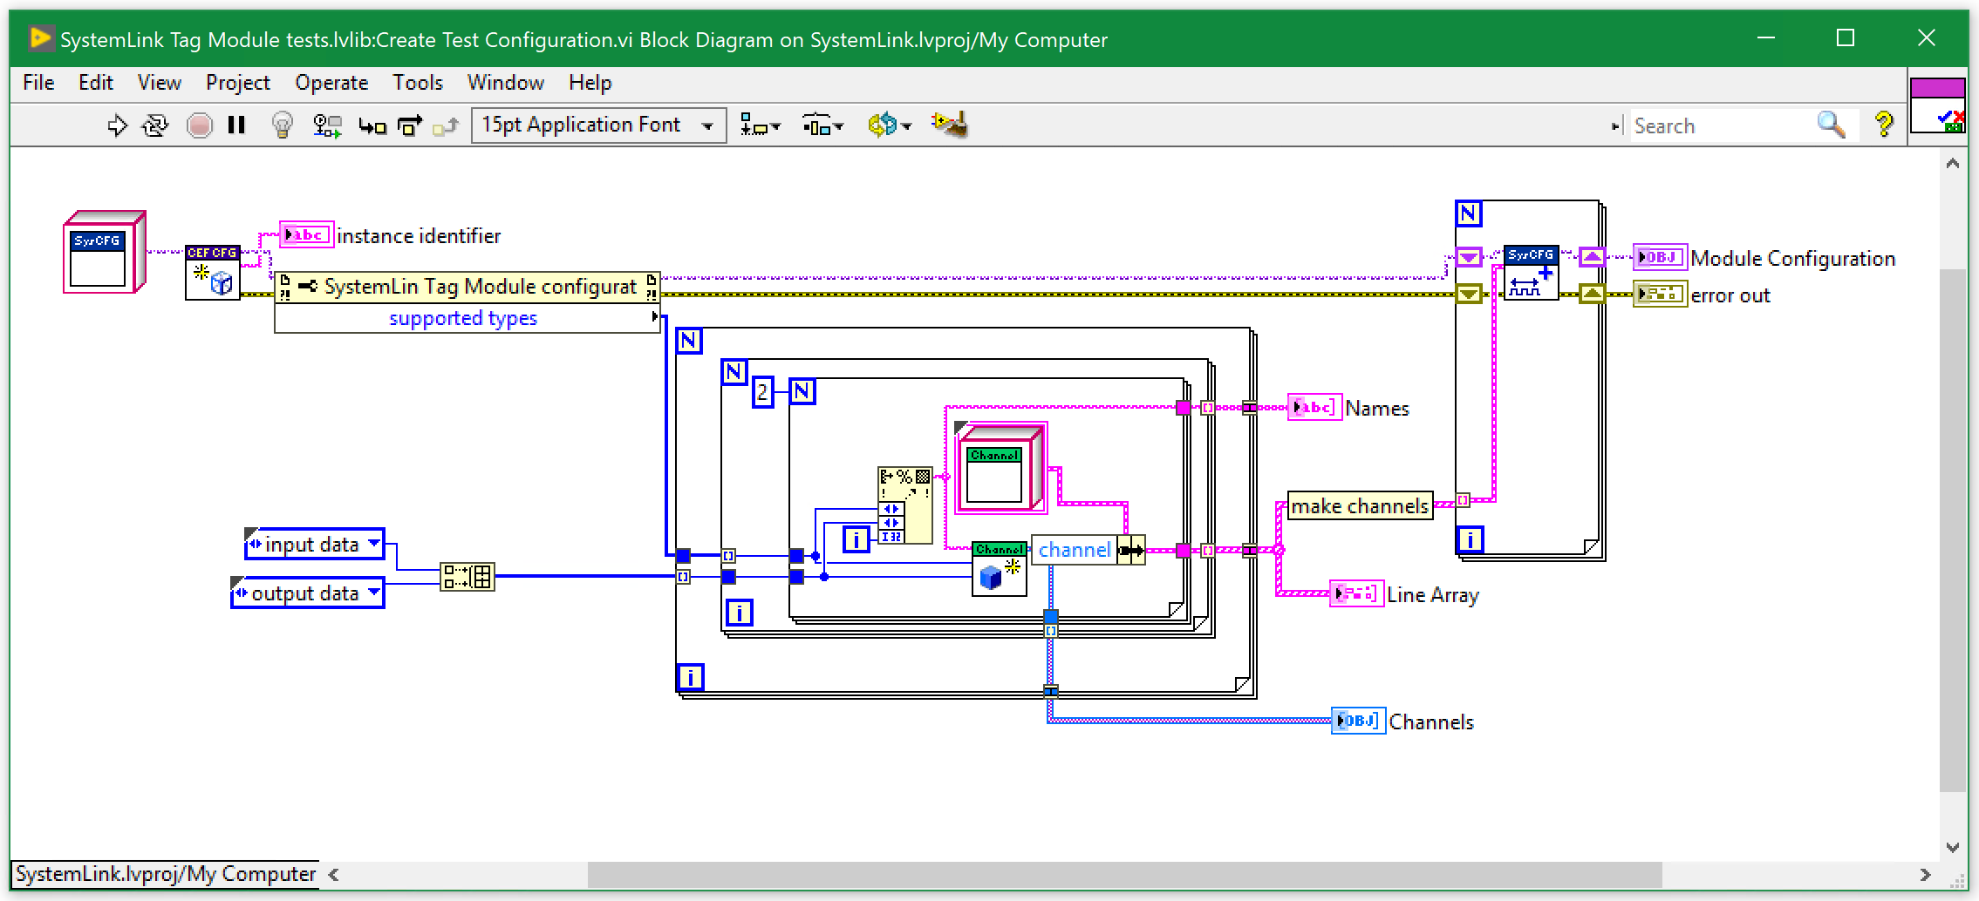
Create Test Configuration

Slide 17
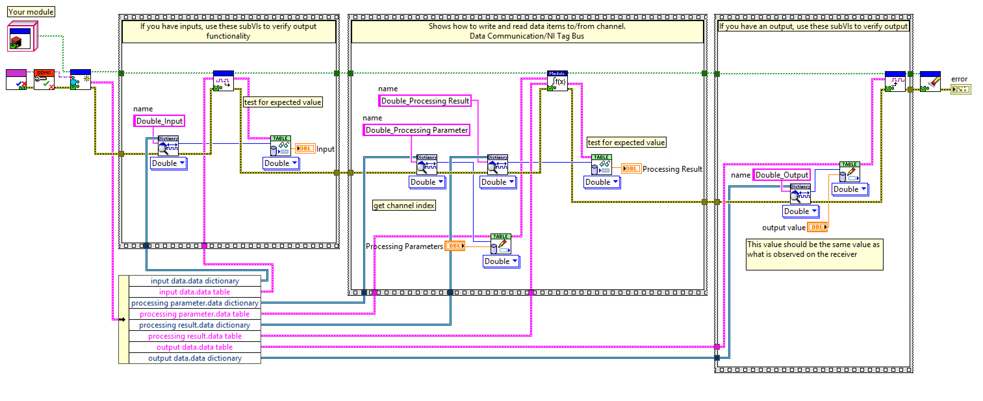
Runtime Test

Slide 18
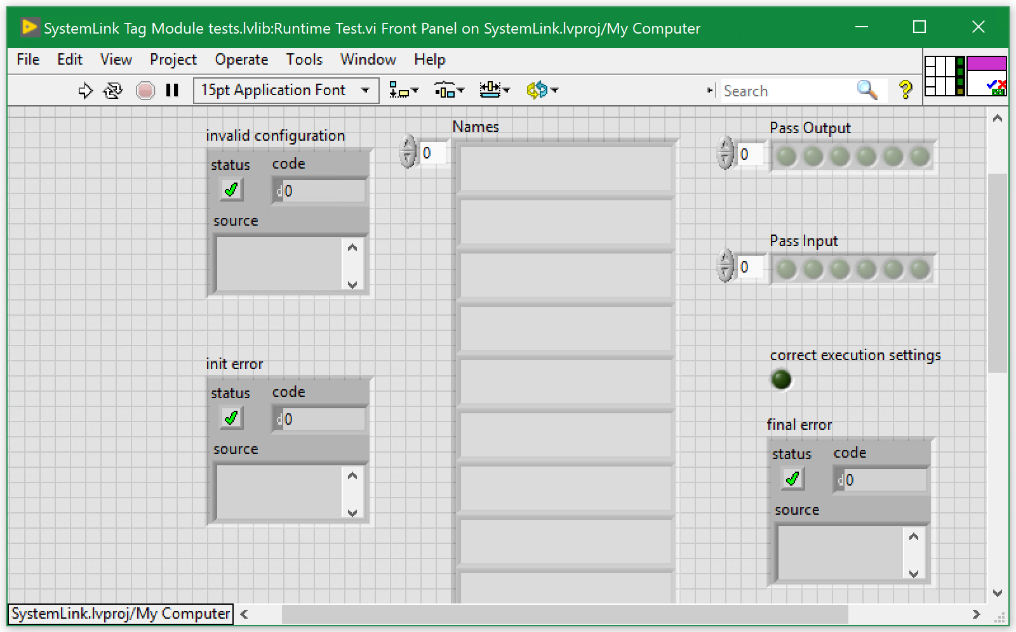
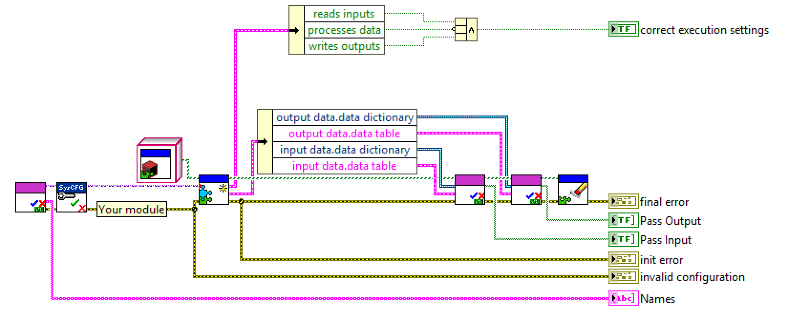
System Link Runtime Test

Slide 19
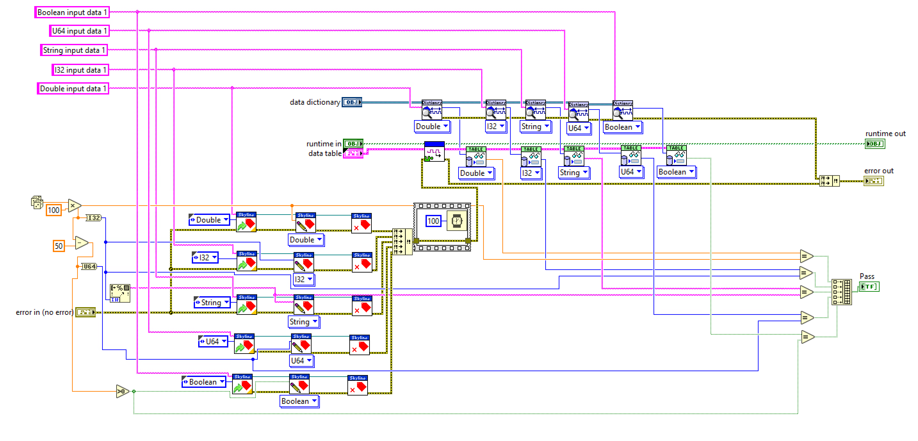
Read Test from the Runtime test.

Slide 20
Set Value for tags
Execute input of the module
Compare values read
Against Expected Values

Slide 21
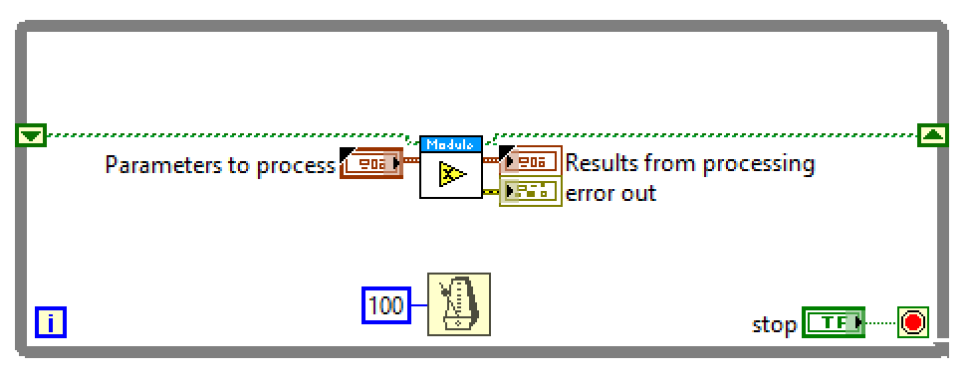
User Process Test

Slide 22
Other Unit Test Frameworks.
Karaia
JKI VI tester.

Slide 23
Tips for testing
You cannot test every possible input, parameter value, etc.
So you must think of a limited set of tests likely to expose bugs.
Think about boundary cases
positive; zero; negative numbers
right at the edge of an array or collection's size
Think about empty cases and error cases
0, -1, null; an empty list or array
test behavior in combination
maybe add usually works, but fails after you call remove
make multiple calls; maybe size fails the second time only

Slide 24
Test-driven development
Unit tests can be written after, during, or even before coding.
test-driven development: Write tests, then write code to pass them.
Imagine that we'd like to add a method subtractWeeks to our Date class, that shifts this Date backward in time by the given number of weeks.
Write code to test this method before it has been written.
Then once we do implement the method, we'll know if it works.

Slide 25
Tests should be self-contained and not care about each other.
"Smells" (bad things to avoid) in tests:
Constrained test order : Test A must run before Test B. (usually a misguided attempt to test order/flow)
Tests call each other : Test A calls Test B's method (calling a shared helper is OK, though)
Mutable shared state : Tests A/B both use a shared object. (If A breaks it, what happens to B?)

Slide 26
Regression testing
regression: When a feature that used to work, no longer works.
Likely to happen when code changes and grows over time.
A new feature/fix can cause a new bug or reintroduce an old bug.
regression testing: Re-executing prior unit tests after a change.
Often done by scripts during automated testing.
Used to ensure that old fixed bugs are still fixed.
Gives your app a minimum level of working functionality.
Many products have a set of mandatory check-in tests that must pass before code can be added to a source code repository.

Slide 27
Trustworthy tests
Test one thing at a time per test method.
10 small tests are much better than 1 test 10x as large.
Each test method should have few (likely 1) assert statements.
If you assert many things, the first that fails stops the test.
You won't know whether a later assertion would have failed.
Tests should avoid logic.
minimize if/else, loops, switch, etc.
avoid try/catch
If it's supposed to throw, use expected= ... if not, let JUnit catch it.
Torture tests are okay, but only in addition to simple tests.

Slide 28
Bugs and Unite Test
What to do with BUgs

Slide 29
Automation - Test
Source control providers include hooks to continuous integration services
Automatically run all build/test operations on every commit
Track unit test results to a particular commit of files
Make sure that you didn’t break it
Require commit to pass all tests before it can be merged
Prevents one developer’s mistake from hurting everyone
Don’t be that guy

Slide 30
More Resources
http://www.labviewcraftsmen.com/blog/do-you-unit-test
https://courses.cs.washington.edu/courses/cse331/11sp/lectures/slides/09-junit.ppt
Notes:
https://www.youtube.com/watch?v=e2Poh0bzcwk

